Slide 1
Collection Framework
*
‹#›
Notes:
‹#›

Slide 2
Any group of individual objects which are represented as a single unit is known as the collection of the objects. In Java, a separate framework named the “Collection Framework” has been defined in JDK 1.2 which holds all the collection classes and interface in it.
The Collection interface (java.util.Collection) and Map interface (java.util.Map) are the two main “root” interfaces of Java collection classes.
‹#›

Slide 3
What is a Framework?
A framework is a set of classes and interfaces which provide a ready-made architecture.
In order to implement a new feature or a class, there is no need to define a framework.
However, an optimal object-oriented design always includes a framework with a collection of classes such that all the classes perform the same kind of task.
‹#›

Slide 4
The Collections Framework
A collection allows a group of objects to be treated as a single unit.
Arbitrary objects can be stored, retrieved, and manipulated as elements of collections.
The collections framework presents a set of standard utility classes for managing such collections provided in the java.util package.
The entire collections framework is designed around a set of standard interfaces.
Several standard implementations (such as LinkedList, HashSet, and TreeSet) of these interfaces are provided.
The algorithms provide a standard means of manipulating collections.
‹#›

Slide 5
The Collections Framework
Collections in Java similar to STL Containers from C++.
The collection framework comprises of three main parts:
The core interfaces that allow collections to be manipulated independently of their implementation. These interfaces define the common functionality exhibited by collections and facilitate data exchange between collections.
A small set of implementations (i.e., concrete classes, listed in that are specific implementations of the core interfaces, providing data structures that a program can use readily.
An assortment of static utility methods that can be used to perform various operations on collections, such as sorting and searching,or creating customized collections.
‹#›

Slide 6
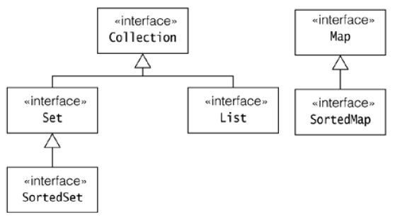
The Collections Framework
‹#›

Slide 7
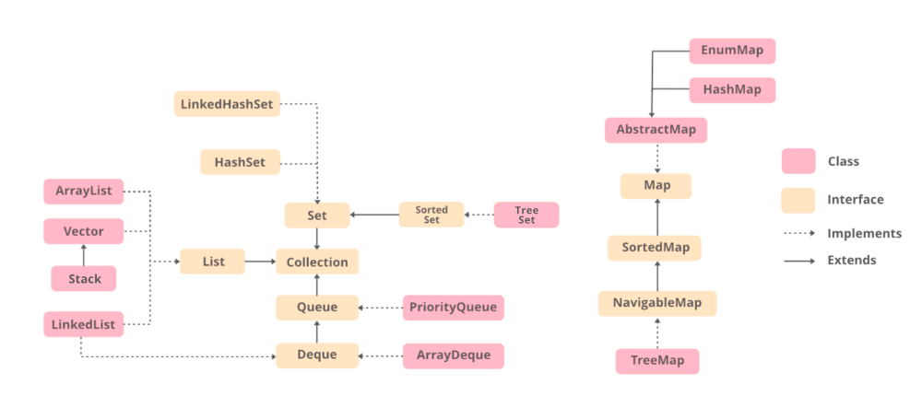
‹#›

Slide 8
The “Collection” Interface
The Collection interface is the foundation upon which the collections framework is built.
It declares the core methods that all collections will have.
Basic Operations: The basic operations are used to query a collection about its contents and allow elements to be added and removed from a collection.
- int size()
- boolean isEmpty()
- boolean contains(Object element)
- boolean add(Object element)
- boolean remove(Object element)
- Iterator iterator( )
‹#›

Slide 9
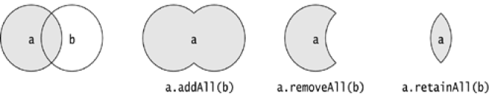
Collections
Bulk Operations
These operations perform on a collection as a single unit.
boolean containsAll(Collection c)
boolean addAll(Collection c) // Optional
boolean removeAll(Collection c)
boolean retainAll(Collection c)
void clear()
‹#›

Slide 10
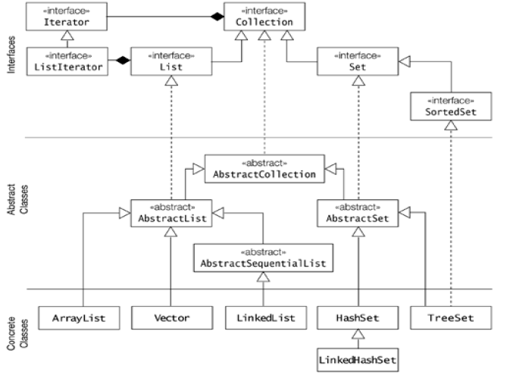
Collection Framework
‹#›

Slide 11
The “List” Interface
The List interface extends Collection and declares the behavior of a collection that stores a sequence of elements.
Elements can be inserted or accessed by their position in the list, using a zero-based index.
A list may contain duplicate elements.
Methods: void add(int index, Object obj)
boolean addAll(int index, Collection c)
Object get(int index)
int indexOf(Object obj)
int lastIndexOf(Object obj)
ListIterator listIterator( )
Object remove(int index)
Object set(int index, Object obj)
‹#›

Slide 12
The Set & SortedSet Interfaces
The Set interface defines a set. It extends Collection and declares the behavior of a collection that does not allow duplicate elements.
It does not define any additional methods of its own.
The SortedSet interface extends Set and declares the behavior of a set sorted in ascending order.
Methods:
Object first( )
Object last( )
SortedSet subSet(Object start, Object end)
SortedSet headSet(Object end)
SortedSet tailSet(Object start)
‹#›

Slide 13
List <T> al = new ArrayList<> ();
List <T> ll = new LinkedList<> ();
List <T> v = new Vector<> ();
Where T is the type of the object
‹#›

Slide 14
// Java program to demonstrate the
// working of ArrayList
import java.io.*;
import java.util.*;
‹#›

Slide 15
class demo {
// Main Method
public static void main(String[] args)
{
// Declaring the ArrayList with
// initial size n
ArrayList<Integer> al = new ArrayList<Integer>();
‹#›

Slide 16
// Appending new elements at
// the end of the list
for (int i = 1; i <= 5; i++)
al.add(i);
// Printing elements
System.out.println(al);
// Remove element at index 3
al.remove(3);
‹#›

Slide 17
// Displaying the ArrayList
// after deletion
System.out.println(al);
// Printing elements one by one
for (int i = 0; i < al.size(); i++)
System.out.print(al.get(i) + " ");
}
}
‹#›

Slide 18
Iterator
A collection provides an iterator which allows sequential access to the elements of a collection.
An iterator can be obtained by calling the following method of the Collection interface: Iterator iterator()
Returns an object which implements the Iterator interface.
Methods of Iterator interface:
boolean hasNext()
Object next()
Object previous( )
Object remove()
void add(Object obj)
boolean hasPrevious( )
void set(Objectobj)
‹#›

Slide 19
Iterator
In general, to use an iterator to cycle through the contents of a collection, follow these steps:
Obtain an iterator to the start of the collection by calling the collection’s iterator( ) method.
Set up a loop that makes a call to hasNext( ). Have the loop iterate as long as hasNext( ) returns true.
Within the loop, obtain each element by calling next( ).
For collections that implement List, you can also obtain an iterator by calling ListIterator.
ListIterator is available only to those collections that implement the List interface.
‹#›

Slide 20
ArrayList class
The ArrayList class extends AbstractList and implements the List interface.
ArrayList supports dynamic arrays that can grow as needed.
Array lists are created with an initial size. When this size is exceeded, the collection is automatically enlarged. When objects are removed, the array may be shrunk.
Constructors:
ArrayList( )
ArrayList(Collection c)
ArrayList(int capacity)
You can increase the capacity of an ArrayList object manually by calling ensureCapacity( ).
void ensureCapacity(int cap)
‹#›

Slide 21
LinkedList class
The LinkedList class extends AbstractSequentialList and implements the List interface.
It provides a linked-list data structure.
Constructors:
LinkedList( )
LinkedList(Collection c)
In addition to the methods that it inherits, the LinkedList class defines some useful methods of its own for manipulating and accessing lists.
void addFirst(Object obj)
void addLast(Object obj)
‹#›

Slide 22
LinkedList class
Object getFirst( )
Object getLast( )
Object removeFirst( )
Object removeLast( )
To insert items at a specific location, use the add(int, Object) form of add( ).
‹#›

Slide 23
import java.util.LinkedList;
class Main {
public static void main(String[] args){
// create linkedlist
LinkedList<String> animals = new LinkedList<>();
// Add elements to LinkedList
animals.add("Dog");
animals.add("Cat");
animals.add("Cow");
System.out.println("LinkedList: " + animals);
}
}
‹#›

Slide 24
// Java program to demonstrate the
// working of LinkedList
import java.io.*;
import java.util.*;
class demo {
// Main Method
public static void main(String[] args)
{
// Declaring the LinkedList
LinkedList<Integer> ll = new LinkedList<Integer>();
// Appending new elements at
// the end of the list
for (int i = 1; i <= 5; i++)
ll.add(i);
‹#›

Slide 25
// Printing elements
System.out.println(ll);
// Remove element at index 3
ll.remove(3);
// Displaying the List
// after deletion
System.out.println(ll);
// Printing elements one by one
for (int i = 0; i < ll.size(); i++)
System.out.print(ll.get(i) + " ");
}
}
‹#›

Slide 26
Sets
A Set models a mathematical set that is, it is an unordered collection of distinct objects.
Implementations of the Set interface do not allow duplicate elements, its add() and addAll() methods will not store duplicates.
‹#›

Slide 27
Hash Set
The HashSet class extends AbstractSet and implements the Set interface.
It creates a collection that uses a hash table for storage.
Since this implementation uses a hash table, it offers near constant-time performance for most operations.
A HashSet does not guarantee any ordering of the elements.
HashSet does not define any additional methods beyond those provided by its superclasses and interfaces.
Constructors:
HashSet()
HashSet(Collection c)
HashSet(int initialCapacity)
‹#›

Slide 28
HashSet<String>result_set = new HashSet<String>();
for (String element : h_set){
System.out.println(h_set2.contains(element) ? "Yes" : "No");
}

Slide 29
LinkedHashSet class
This class extends HashSet, but adds no members of its own.
LinkedHashSet maintains a linked list of the entries in the set, in the order in which they were inserted. This allows insertion-order iteration over the set.
When cycling through a LinkedHashSet using an iterator, the elements will be returned in the order in which they were inserted.
‹#›

Slide 30
TreeSet Class
TreeSet provides an implementation of the Set interface that uses a tree for storage.
Objects are stored in sorted, ascending order.
Access and retrieval times are quite fast, which makes TreeSet an excellent choice when storing large amounts of sorted information that must be found quickly.
Constructors:
TreeSet( )
TreeSet(Collection c)
TreeSet(SortedSet ss)
TreeSet(Comparator comp)
‹#›

Slide 31
Working with Maps
A Map defines mappings from keys to values. The <key, value> pair is called an entry.
A map does not allow duplicate keys, in other words, the keys are unique.
Both the keys and the values must be objects.
A map is not a collection and the Map interface does not extend the Collection interface.
Maps can accept a null key and null values.
‹#›

Slide 32
The Map Interface
Object put(Object key, Object value)
Object get(Object key)
Object remove(Object key)
boolean containsKey(Object key)
boolean containsValue(Object value)
int size()
boolean isEmpty()
void putAll(Map t)
void clear()
boolean equals(Object obj)
‹#›

Slide 33
The SortedMap interface
The SortedMap interface extends Map. It ensures that the entries are maintained in ascending key order.
Methods:
Object firstKey( )
Object lastKey( )
SortedMap subMap(Object start, Object end)
SortedMap headMap(Object end)
SortedMap tailMap(Object start)
‹#›

Slide 34
The Map Classes
AbstractMap
Implements most of the Map interface.
HashMap
Extends AbstractMap to use a hash table.
TreeMap
Extends AbstractMap to use a tree.
LinkedHashMap
Extends HashMap to allow insertion-order iterations.
‹#›

Slide 35
The HashMap Class
The HashMap class uses a hash table to implement the Map interface.
This allows the execution time of basic operations, such as get( ) and put( ), to remain constant even for large sets.
Constructors :
HashMap( )
HashMap(Map m)
HashMap(int capacity)
HashMap(int capacity, float fillRatio)
HashMap implements Map and extends AbstractMap. It does not add any methods of its own.
Hash map does not guarantee the order of its elements.
‹#›

Slide 36
The TreeMap Class
The TreeMap class implements the Map interface by using a tree.
A TreeMap provides an efficient means of storing key/value pairs in sorted order, and allows rapid retrieval.
A tree map guarantees that its elements will be sorted in ascending key order.
Constructors:
TreeMap( )
TreeMap(Map m)
TreeMap(SortedMap sm)
TreeMap implements SortedMap and extends AbstractMap. It does not define any additional methods of its own.
‹#›

Slide 37
LinkedHashMap Class
This class extends HashMap. LinkedHashMap maintains a linked list of the entries in the map, in the order in which they were inserted.
This allows insertion-order iteration over the map. That is, when iterating a LinkedHashMap, the elements will be returned in the order in which they were inserted.
Constructors:
LinkedHashMap( )
LinkedHashMap(Map m)
LinkedHashMap(int capacity)
IdentityHashMap Class
Java 2, version 1.4 adds the IdentityHashMap class. This class implements AbstractMap.It is similar to HashMap except that it uses reference equality when comparing elements.
‹#›

Slide 38
Comparators
Both TreeSet and TreeMap store elements in sorted order. However, it is the comparator that defines precisely what “sorted order” means.
By default, these classes store their elements by using what Java refers to as “natural ordering,” which is usually the ordering that you would expect.
You want to order elements a different way, then specify a Comparator object when you construct the set or map.
The Comparator interface defines two methods: compare( ) and equals( ).
‹#›

Slide 39
Comparators
int compare(Object obj1, Object obj2)
obj1 and obj2 are the objects to be compared. This method returns zero if the objects are equal. It returns a positive value if obj1 is greater than obj2. Otherwise, a negative value is returned.
boolean equals(Object obj)
obj is the object to be tested for equality. The method returns true if obj and the invoking object are both Comparator objects and use the same ordering. Otherwise, it returns false.
‹#›

Slide 40
Vector class
Vector implements a dynamic array. It is similar to ArrayList, but with two differences:
Vector is synchronized
it contains many legacy methods that are not part of the collections framework
Vector extends AbstractList and implement the List interface.
Constructors:
Vector( )
Vector(int size)
Vector(int size, int incr)
Vector(Collection c)
‹#›

Slide 41
Vector class
Vector defines these protected data members:
int capacityIncrement;
int elementCount;
Object elementData[ ];
In addition to the collections methods defined by List, Vector defines several legacy methods
void addElement(Object element)
void insertElementAt(Object element, int index)
int capacity( )
Object clone( )
boolean contains(Object element)
void copyInto(Object array[ ])
‹#›

Slide 42
Vector class
Object elementAt(int index)
Object firstElement( )
int indexOf(Object element)
void removeAllElements( )
boolean removeElement(Object element)
void trimToSize()
Enumeration elements( )
‹#›

Slide 43
Stack class
Stack is a subclass of Vector that implements a standard last-in, first-out stack.
Stack only defines the default constructor, which creates an empty stack.
Methods added to Stack
boolean empty( )
Object peek( )
Object pop( )
Object push(Object element)
int search(Object element)
‹#›

Slide 44
Hashtable
Hashtable is a concrete implementation of a Dictionary.
It implements the Map interface. Thus, Hashtable is now integrated into the collections framework.
It is similar to HashMap, but is synchronized.
Like HashMap, Hashtable stores key/value pairs in a hash table. A hash table can only store objects that override hashCode( ) and equals( ) methods that are defined by Object.
Constructors:
Hashtable( )
Hashtable(int size)
Hashtable( Map m )
‹#›

Slide 45
Hashtable
Object clone( )
boolean contains(Object value)
boolean containsKey(Object key)
boolean containsValue(Object value)
Enumeration elements( )
boolean isEmpty( )
void rehash( )
‹#›

Slide 46
Enumeration
The Enumeration interface defines the methods by which you can enumerate (obtain one at a time) the elements in a collection of objects.
boolean hasMoreElements( ) When implemented, it must return true while there are still more elements to extract, and false when all the elements have been enumerated.
Object nextElement( ) This returns the next object in the enumeration as a generic Object reference.
‹#›

Slide 47
Enumeration
public static void main(String[] args)
{
Vector<String> v=new Vector<String>(); v.add("Amit"); v.add("Raj");
v.add("Pathak"); v.add("Sumit");
v.add("Aron"); v.add("Trek");
Enumeration<String> en=v.elements(); while(en.hasMoreElements())
{
String value=(String) en.nextElement(); System.out.println(value);
}
}
‹#›
Notes:
‹#›

